Slide 1
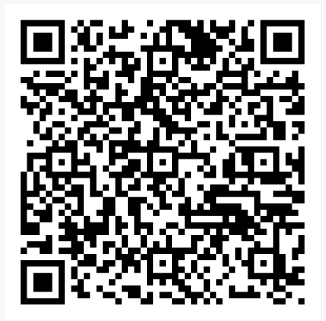
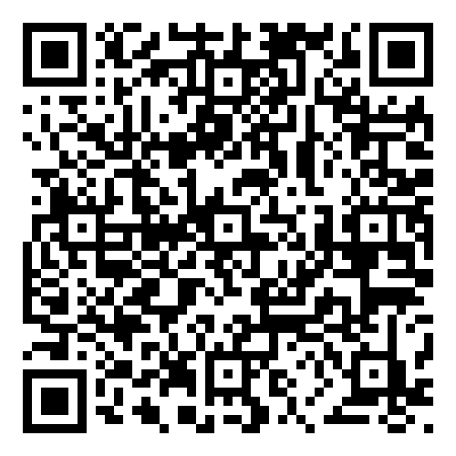
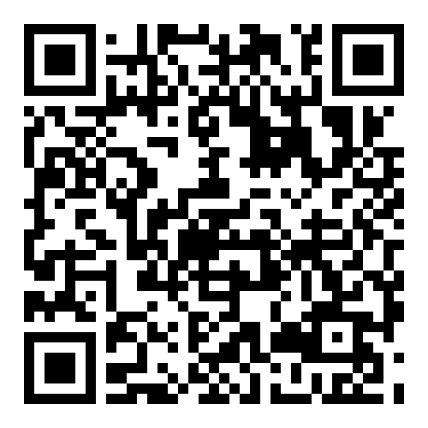
Tonight’s Presentation
Course Selection Worksheet
Course Catalog

Slide 2
The Foundation High School Program
+ Endorsement (FHSP+E)
2024-2025 Course Selection Information
for High School Students and Parents
Notes:
The information contained in this presentation is accurate as of December 18, 2019. Information will be updated online if/when changes should occur based on Texas Education Agency decisions.

Slide 3
KHS Counselors

Slide 4
Foundation High School Program + Endorsement Graduation Requirements (26 credits)
English – 4 credits
English I, II, III, and an additional/advanced English
Math – 4 credits
Algebra I, Geometry, and 2 additional/advanced maths
Science – 4 credits
Biology, and one course from IPC, or Chemistry, or Physics, and 2 additional/advanced sciences
Social Studies – 3 credits
US History, 0.5 credit Government, 0.5 credit Economics, and either World History or World Geography
LOTE – 2 credits
Credits must be in the same language
Fine Arts – 1 credit
Physical Education – 1 credit
Health – 0.5 credit (KISD requirement)
Electives – 6.5 credits
one elective must have a communication skills component
Endorsement:
Students are expected to earn an endorsement in one of 5 areas. Each endorsement requires electives related their specific endorsement.
Notes:
The Foundation requires 22-credits, while the FHSP + endorsement requires a total of 26 credits, including a fourth math and a fourth science. The four additional endorsement credits are built on top of the foundation.

Slide 5
Basic Information
All students must choose at least one endorsement at the time they enter 9th grade.
There are multiple pathways to complete each endorsement.
The pathway should be selected based on the student’s individual interests and goals.
Students may change and/or confirm the endorsement(s) along with their course selections each year.
Many students will earn multiple endorsements.
For students unsure of endorsement, choose Multidisciplinary.
Notes:
All students are required to choose an endorsement in one of 5 areas: STEM, Business & Industry, Public Services, Arts & Humanities, or Multidisciplinary Studies. We’ll have more information on the endorsement areas a little later in this presentation.
The endorsement should be chosen based on the student’s individual interests and career goals, and should align with courses the student intends to take while in high school. There are notes throughout the course catalog about which endorsement areas certain courses support.

Slide 6
Distinguished Level of Achievement (DLA)
The Distinguished Level of Achievement (DLA) is earned through successful completion of:
All requirements for the Foundation High School Program, plus
The requirements of at least one endorsement, including
Algebra II among the four required math credits, and
A fourth science credit
A student must graduate with a Distinguished Level of Achievement (DLA) to be considered for the Top 10% and eligibility for automatic admission to a Texas public college or university.
Notes:
Before we go any further, it’s important to note that each of the five endorsements require a fourth math credit and a fourth science credit.
Algebra II is required for the Distinguished Level of Achievement, or DLA.
The DLA is important because it is REQUIRED for the student to be considered for the Top 10% and therefore be eligible for automatic admission to a Texas public college or university.
The requirements for a DLA are pretty much the same as those for any endorsement; but, Algebra II is specified as a requirement for earning the DLA, regardless of which endorsement you choose to pursue.
More information about the importance of Algebra II credit and the DLA and will be covered later in this presentation.

Slide 7
The Endorsements
STEM (Science – Technology – Engineering – Math)
Business & Industry
Public Services
Arts & Humanities
Multidisciplinary Studies
Notes:
There are five endorsement categories. Each one is quite different and has its own requirements.
When selecting the endorsement, students should think about the courses they want to take and their own specific areas of interest.
The endorsements are listed at the top of the course selection sheet.
The course catalog includes information on the endorsements in greater detail, but we will briefly go over each one here.

Slide 8
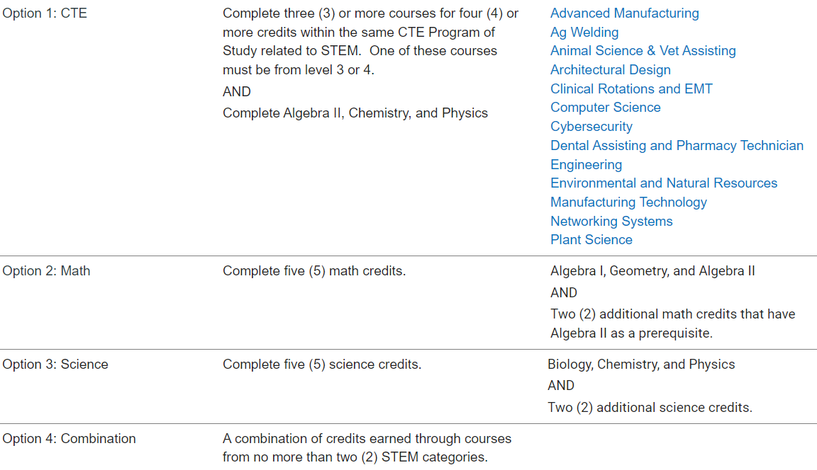
STEM – Science • Technology • Engineering • Math
Notes:
STEM relates to courses of study in advanced math, science, computer science, Career & Technical Education engineering courses, or a combination of courses from up to two of these categories.

Slide 9
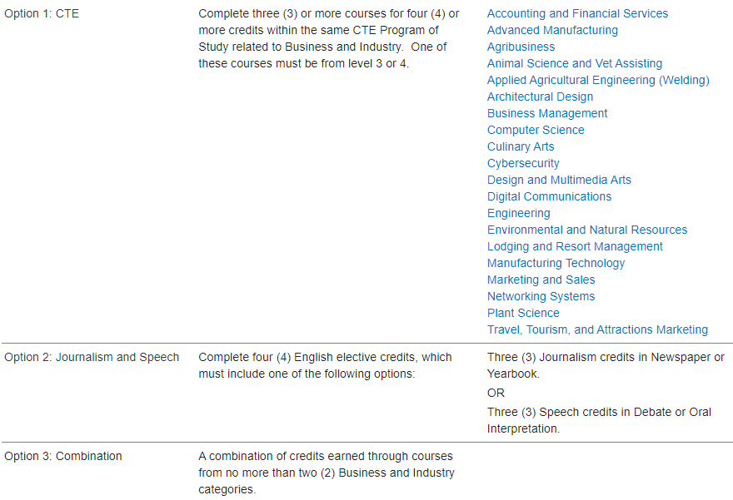
Business & Industry
Notes:
The Business and Industry endorsement includes courses of study from a wide variety of areas of Career & Technical Education, English, in the fields of Journalism or Speech, Technology, or a combination from various Business & Industry categories.

Slide 10
Public Services
Notes:
The Public Services endorsement is comprised of Career and Technical Education courses of study in the areas of Health Science, education, cosmetology, law enforcement and JROTC.
To earn this endorsement, all four CTE credits must be earned in the same category.

Slide 11
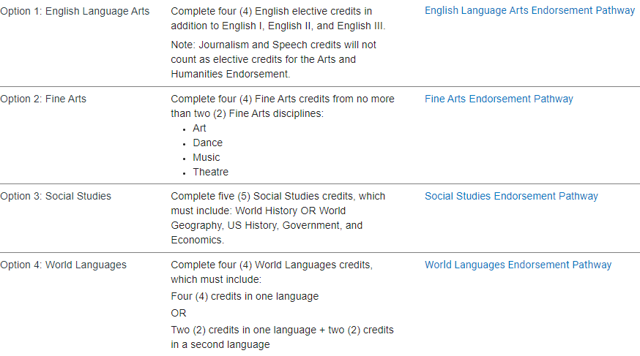
Arts & Humanities
Notes:
The Arts and Humanities endorsement relates to English--other than journalism and speech, Social Studies, Languages Other than English, as well as to each of the fine arts disciplines, including Art, Dance, Music and Theatre.
This endorsement cannot be earned through a combination of courses from different Arts & Humanities categories.

Slide 12
Multidisciplinary Studies
Notes:
The multidisciplinary studies endorsement allows students to select their course of study from several different areas, and there are various ways to earn this endorsement, including college, career and military readiness, the 4X4, and Advanced Placement, Dual Credit, or International Baccalaureate courses.

Slide 13
Top 10% Rule
A student whose class rank* is in the top 10 percent of the graduating class may be eligible for automatic admission consideration at a Texas public college or university with the exception of the University of Texas at Austin, which is top 6%.
*Class rank must be based on the student’s rank at the end of the 11th grade, middle of 12th grade, or at high school graduation, whichever is most recent at the college or university’s application deadline.

Slide 14
Katy ISD Grading Scale
The alphabetic identification for scores 70-79 is a C.
Students in the top 10% will be provided their numeric class rank in the spring semester of their junior year.
Transcripts will include the numeric class rank only for students in the top 10%.
Students beyond the top 10% will be provided their quartile rank in the spring semester of their junior year.
Notes:
In the fall of 2019, Katy ISD made some significant changes to the grading policy, removing the D from the grading scale. This benefits students by aligning the district grading scale with other school districts in the state, thus allowing Katy ISD students to be competitive in college admissions and scholarship application processes.

Slide 15
Gifted and Talented Typical Secondary Course Pathway
The courses listed below are for students who have been identified Gifted & Talented through the Katy ISD screening process.
Grade | Math |  |  | ELA | Science | Social Studies
8th | 8th grade Math | Algebra I-GT | Algebra II-GT
9th | Algebra 1 | Geometry KAP/GT | AP PreCalculus-GT | English 1 KAP/GT | Biology KAP/GT | AP Human Geography GT
10th | Geometry KAP/GT | Algebra II KAP/GT | AP Statistics-GT | English 2 KAP/GT | Chemistry KAP/GT | AP World History GT
11th | Algebra II KAP/GT | AP PreCalculus-GT or AP Statistics-GT | AP Calculus BC-GT | AP English Language & Comp GT | AP Physics I GT AP Biology GT AP Chemistry GT AP Environmental GT | AP US History GT
12th | AP PreCalculus- GT or AP Statistics-GT | AP Calculus BC-GT or AP Statistics-GT | Multi Variable Calculus KAP/GT | AP English Literature & Comp GT | AP Physics II GT AP Biology GT AP Chemistry GT AP Environmental GT | AP Macroeconomics GT AP Microeconomics GT AP Government GT
Students identified as GT who self-select out of a GT course option at any time will be exited from that content area.
Students who take World Geography KAP or World History KAP at any time, summer included, will be exited from GT identification in Social Studies.

Slide 16
Miller Career & Technology Center is a central site for innovative CTE courses not available at the home campuses.
MCTC courses are only available for 11th and 12th grade students.
Students must apply and be accepted to MCTC courses.
Many MCTC courses require specific prerequisites.
MCTC Course Catalog
Notes:
Miller Career

Slide 17
Dual Credit Courses
If you are interested in taking Dual Credit Courses through HCC as a 9th grader, you and your parents need to attend the Dual Credit informational meeting on February 14th at 6:30 PM in the Katy High School Commons.

Slide 18
Choosing Courses for Next Year
You will choose your courses in SchooLinks - Course Planner (in MyKatyCloud)
The Course Planner and course catalog will be available to view in SchooLinks beginning February 5th.
Course descriptions & prerequisites are outlined in the SchooLinks course catalog.
Every student will meet with the school counselor to review credits and finalize course requests.
Notes:
When making course selections, please review the course catalog. It is very important to be mindful of the student’s graduation plan and endorsement requirements
Please be aware of any prerequisites, grade restrictions, course fees, or after school commitments associated with different courses and programs. Also, be sure to review “Selecting Courses for the Next School Year” and the Katy ISD schedule change procedures, both on page 35 of the course catalog.
The course selection sheet should be filled out neatly and completely, including alternate choices.
Sometimes a chosen class doesn’t fit in the student’s schedule. It is important to list alternate courses that are of interest to the student just in case one of the first choice classes doesn’t work with the schedule.
Turn in the completed course selection sheet according to campus instructions.
Students will meet individually with the school counselor to review credits and input course requests for next year. The school counselor can help with any questions about course selections.

Slide 19
Choosing Courses for Next Year
Choose or review your pathway that leads to your endorsement.
Choose courses from the required subject areas
English
Math
Science
Social Studies
Choose courses from other areas to fill all SEVEN class periods
Courses marked (sem) are one-semester courses. If one course marked (sem) is selected, a second is also required
Notes:
When making course selections, please review the course catalog.
It is important to be aware of any prerequisites, grade restrictions, course fees, or after school commitments associated with different courses and programs. Also, be sure to review “Selecting Courses for the Next School Year” and the Katy ISD schedule change procedures, both on page 35 of the course catalog.
The course selections must include enough courses to fill seven full class periods, and include courses from the required subjects: English, math, science and social studies.
All students are required to take either World Geography or World History; World Geography is an option for 9th grade students.

Slide 20
Course Availability Notice
Students will be allowed to choose any course listed on the course selection worksheet provided they have met prerequisite and grade requirements.
Due to campus staffing, some courses may not be offered at all or may ONLY be offered (asynchronously) online.
Counselors will notify students of course availability as they receive updated course information.
At that time, students can opt to keep the online option or change to an alternate course.
Don’t forget to list alternate courses in SchooLinks!

Slide 21
Choosing Courses for Next Year
Warning! You cannot repeat a course for which you have already earned credit.
Pay close attention to courses that have prerequisites.
Counselors will meet individually with students to review course selections and answer questions.
Notes:
Please be certain to choose the correct classes. If the student is in a high school credit course this year, the same course must not be selected for next year. Credit cannot be earned for a duplicated course.

Slide 22
Schedule Changes
Schedule changes for the 2024-2025 school year will be allowed only in the following cases:
1. Error in scheduling by the school (data entry error)
2. Student has not met course prerequisites
3. Student has already earned credit for the course
4. Change in program (athletics, fine arts, etc.)
5. Level changes as recommended by the teacher and counselor,
with parent and principal approval
6. Student did not meet standard on STAAR/EOC exam.
Notes:
Course verification sheets will be distributed to students a little later in the spring semester. This is the time to confirm that the course requests are what the student wants and needs to take for the 2020-2021 school year. Any changes should be made during the course verification period. Change requests received after the close of course verification will be made for a limited number of reasons.

Slide 23
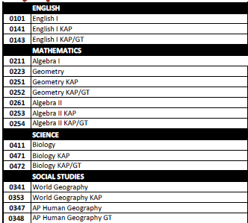
Choosing Your Core Classes:
Choose the appropriate level for English 1, Math, Science, & Social Studies.
If you’re in Algebra 1, you will take Geometry next.
If you are in GT Social Studies, you will take AP/GT Human Geography in 9th grade.
Teachers are your best resource to help determine if KAP is the right choice for you.
Choose courses for all four years. You will review this yearly with your counselor and can make changes.

Slide 24
Choosing Your Other Classes:
After core classes, you have three more spots to fill in your schedule.
Choose an elective that aligns with your pathway.
Start or complete required foreign language.
Consider completing PE, Health/Leadworthy, or Fine Art credit.

Slide 25
Foreign Language Options:
Katy High School only offers Spanish, French, German, & American Sign Language (ASL) on campus.
If you took Spanish for Spanish Speakers 1 & 2 as an 8th grader, you can sign up for Spanish for Speakers 3 & 4 in 9th grade.
Chinese and Latin will only be offered as an online course.
KHS typically has a lot of interest in ASL. Historically we cannot accommodate all ASL 1 requests. It may be offered as an online option for 9th graders. It is imperative that you give us an alternate course in the case that ASL 1 is not available.

Slide 26
PE Options:
Students can earn PE credit from:
PE class (Lifetime Recreation & Outdoor Pursuits)
Athletics
Multi-sport athletes – students can only be in one athletic period during the day. Select the sport whose season comes first. Counselors will adjust schedules as seasons transition.
For all athletic programs, students must have a physical & UIL paperwork completed on RankOne.
Some sports may require summer practice or tryouts.
PE Substitution Courses (Band, Dance, Color Guard, ROTC, & Off-Campus PE)
Cheerleading requires instructor approval at tryouts so students cannot choose this course. If a student makes the squad, counselors will add the course for you.

Slide 27
Fine Arts Options:
Students can earn fine arts credit from:
Band or Jazz Band
Orchestra
Choir
Theatre Arts 1 or Technical Theatre 1
Art
Color Guard
Dance or Dance Team Training
Digital Art & Animation
Floral Design, AP Art History, AP Music Theory (10th-12th Grade Options)
Art Appreciation (KVS only)

Slide 28
Fine Arts – Special Considerations
Band and Color Guard require special consideration:
If the student is in band but not in athletics, select the band option that gives fall PE credit and spring Fine Arts credit.
7051 and 7011B (Band) 7811 and 7801B (Color Guard)
If the student is in both athletics and band, select the band option for the full year Fine Arts credit.
7011 – A&B (Band) 7801 - A&B (Color Guard)
If the student is going to take a first-year dance course for PE credit, choose the appropriate dance course number listed under the Athletics heading.
5505 (Dance 1) or 5506 (Dance Team Training 1)
Notes:
There are some special considerations regarding athletics and fine arts.
If the student is an athlete, only ONE athletics program can be chosen. If the student is a multi-sport athlete, the sport can be changed with the season.
For 9th graders, make sure you aware of any summer requirements for athletics. Not participating in certain required summer practices could impact your placement on the team.
For band and dance courses, it is especially important to choose the right course number, depending on whether the credit will count as PE or fine arts. It

Slide 29
Health Credit
Health (one-semester course)
Principles of Health Science (full-year course)
For students interested in any health science program (Clinical Rotation, EMT, Dental Assistant, Pharmacy Tech, or Medical Assistant), Principles of Health Science is a required prerequisite.
Notes:
There are some special considerations regarding athletics and fine arts.
If the student is an athlete, only ONE athletics program can be chosen. If the student is a multi-sport athlete, the sport can be changed with the season.
For 9th graders, make sure you aware of any summer requirements for athletics. Not participating in certain required summer practices could impact your placement on the team.
For band and dance courses, it is especially important to choose the right course number, depending on whether the credit will count as PE or fine arts. It

Slide 30
Communication Skills Component
One of your electives must fulfill a communication component:
Leadworthy (one-semester)
Professional Communications (one-semester)
Dual Credit Professional Communications (one-semester)
Theatre Arts 1 (full-year)
Debate 1 (full-year)
Notes:
There are some special considerations regarding athletics and fine arts.
If the student is an athlete, only ONE athletics program can be chosen. If the student is a multi-sport athlete, the sport can be changed with the season.
For 9th graders, make sure you aware of any summer requirements for athletics. Not participating in certain required summer practices could impact your placement on the team.
For band and dance courses, it is especially important to choose the right course number, depending on whether the credit will count as PE or fine arts. It

Slide 31
Electives
Students must complete 6.5 total electives to graduate.
Second, third, and fourth year of athletics, band, choir, etc. count as elective credits.
Remember to select electives that align with your intended endorsement or pathway.
Notes:
There are some special considerations regarding athletics and fine arts.
If the student is an athlete, only ONE athletics program can be chosen. If the student is a multi-sport athlete, the sport can be changed with the season.
For 9th graders, make sure you aware of any summer requirements for athletics. Not participating in certain required summer practices could impact your placement on the team.
For band and dance courses, it is especially important to choose the right course number, depending on whether the credit will count as PE or fine arts. It

Slide 32
Counselor Meetings
Remember that counselors will meet with you individually to review your course plan.
Compile a list of questions to review with your counselor at this meeting.
Notes:
There are some special considerations regarding athletics and fine arts.
If the student is an athlete, only ONE athletics program can be chosen. If the student is a multi-sport athlete, the sport can be changed with the season.
For 9th graders, make sure you aware of any summer requirements for athletics. Not participating in certain required summer practices could impact your placement on the team.
For band and dance courses, it is especially important to choose the right course number, depending on whether the credit will count as PE or fine arts. It

Slide 33
Choosing Your Classes
Complete your course selection worksheet for 9th grade classes using the course selection sheet
Enter your 9th grade selections in the Course Planner in SchooLinks from February 5th - February 19th
Use the Course Catalog to complete the remainder of your 4-Year course plan
You will meet individually with your counselor to discuss your plan.

Slide 34
Tonight’s Presentation
Course Selection Worksheet
Course Catalog

